Slide 1
Using Clutter Reduction and Multi-Dimensional Visualization with High Dimensional Data
Jordan Atwell

Slide 2
Introduction to Data
FIFA19
Player statistics for all players in the 2019 season
18k records
89 attributes
Med15
Aggregate report of patient demographics and healthcare facility statistics that had patients with Medicare
15k records
41 attributes

Slide 3
Preprocessing for FIFA19
Dimensional reduction
Records limited to first 1000, then first 500
Using regex to parse strings
Dimensional Reordering using Parallel Coordinates & Scatterplot Matrices
After cleaning: 500 observations, 35 dimensions

Slide 4
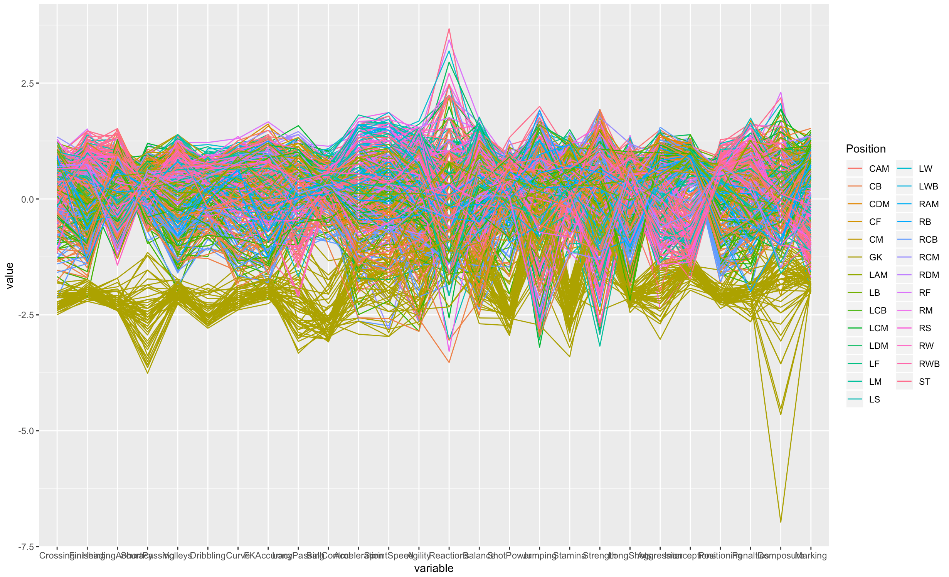

Slide 5
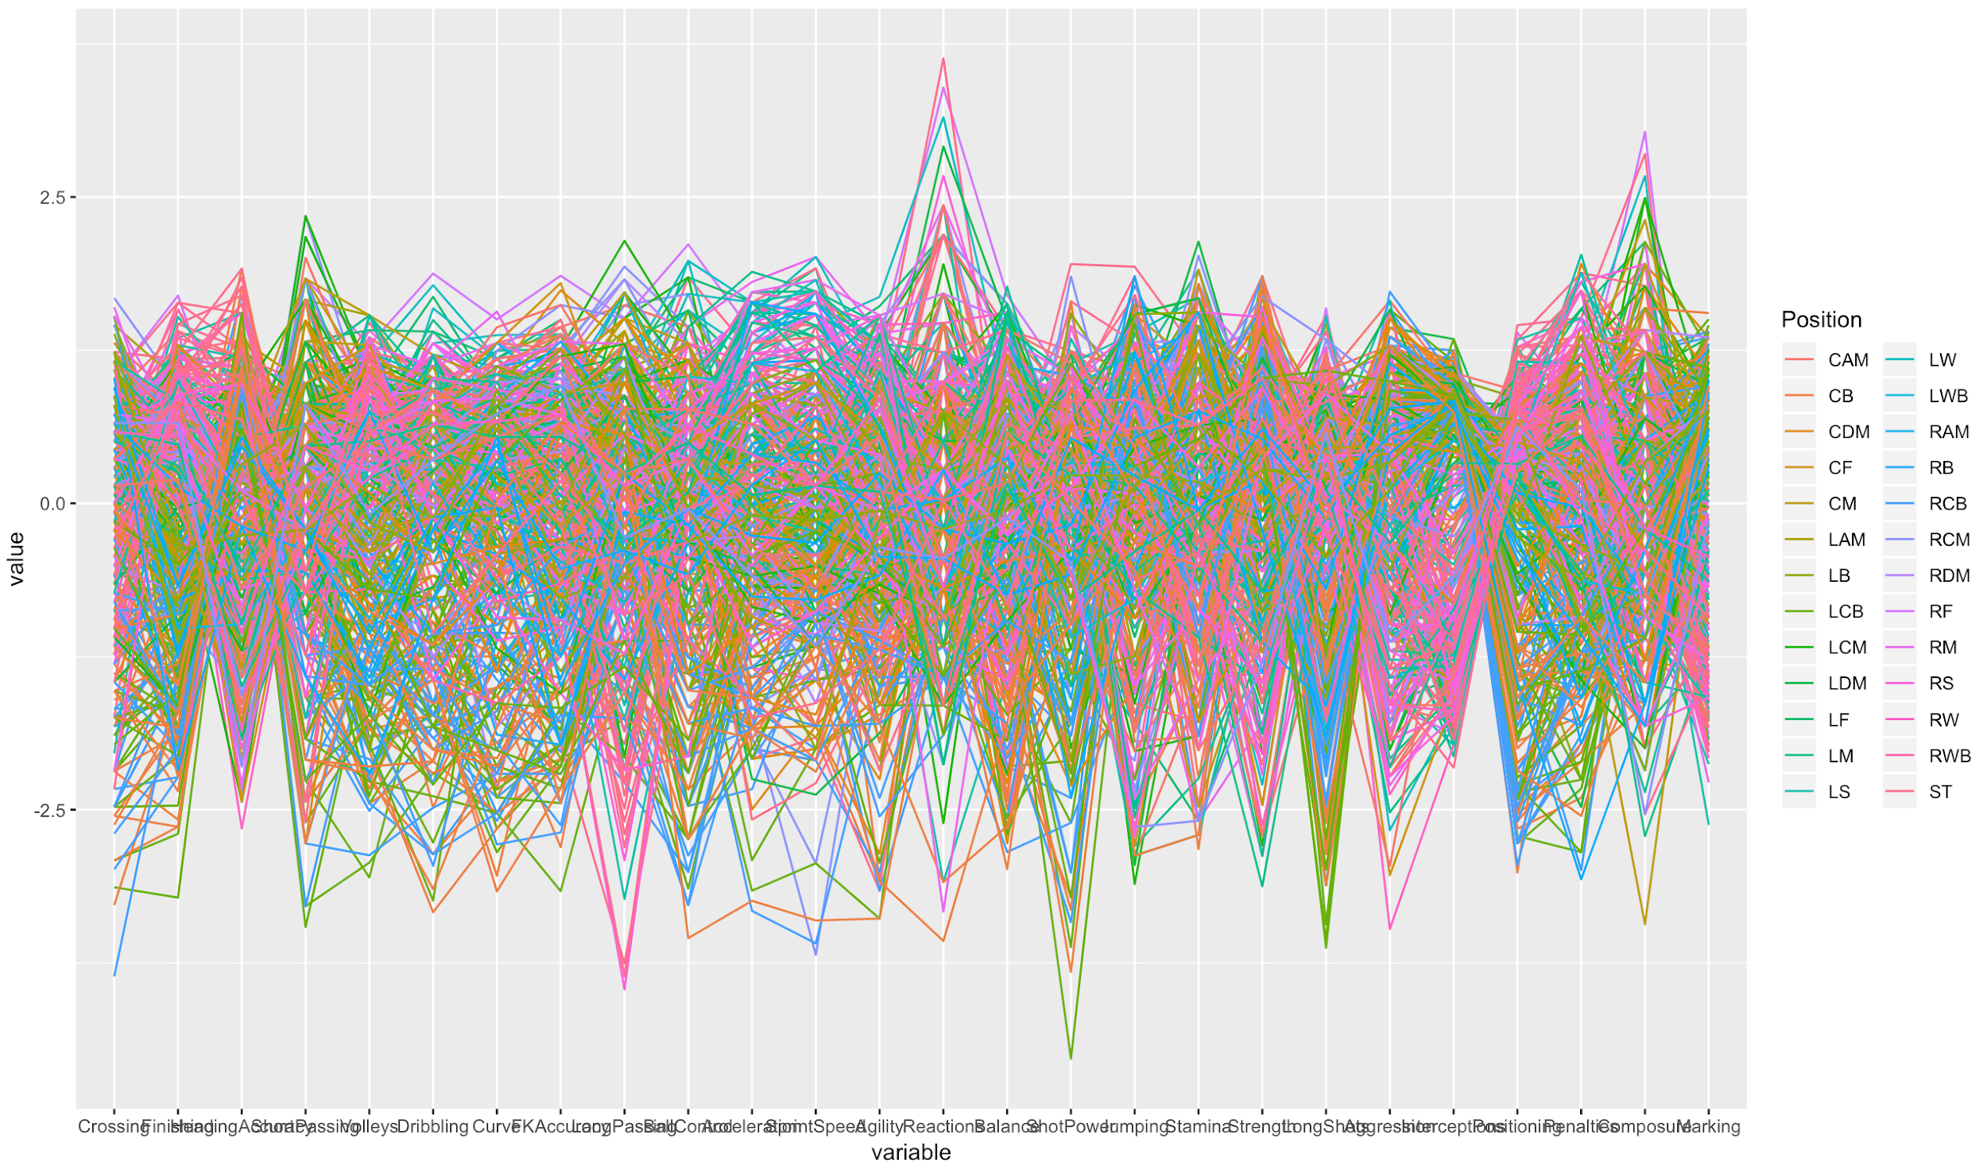

Slide 6
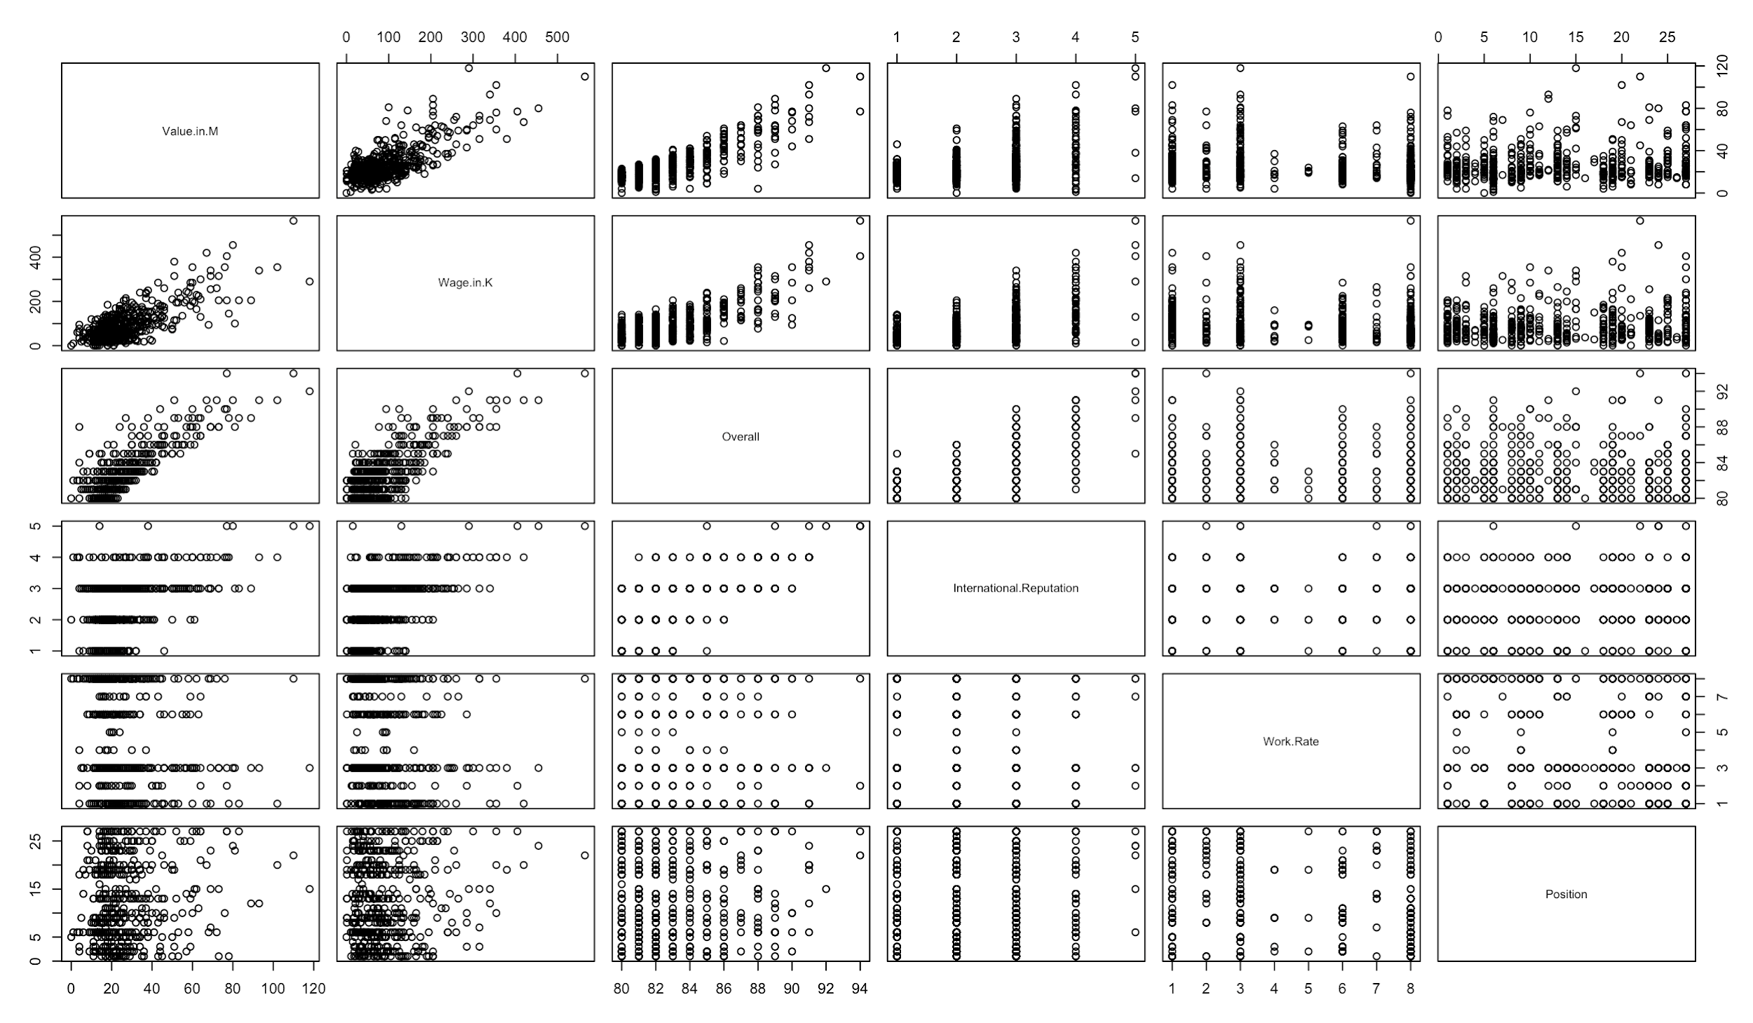

Slide 7
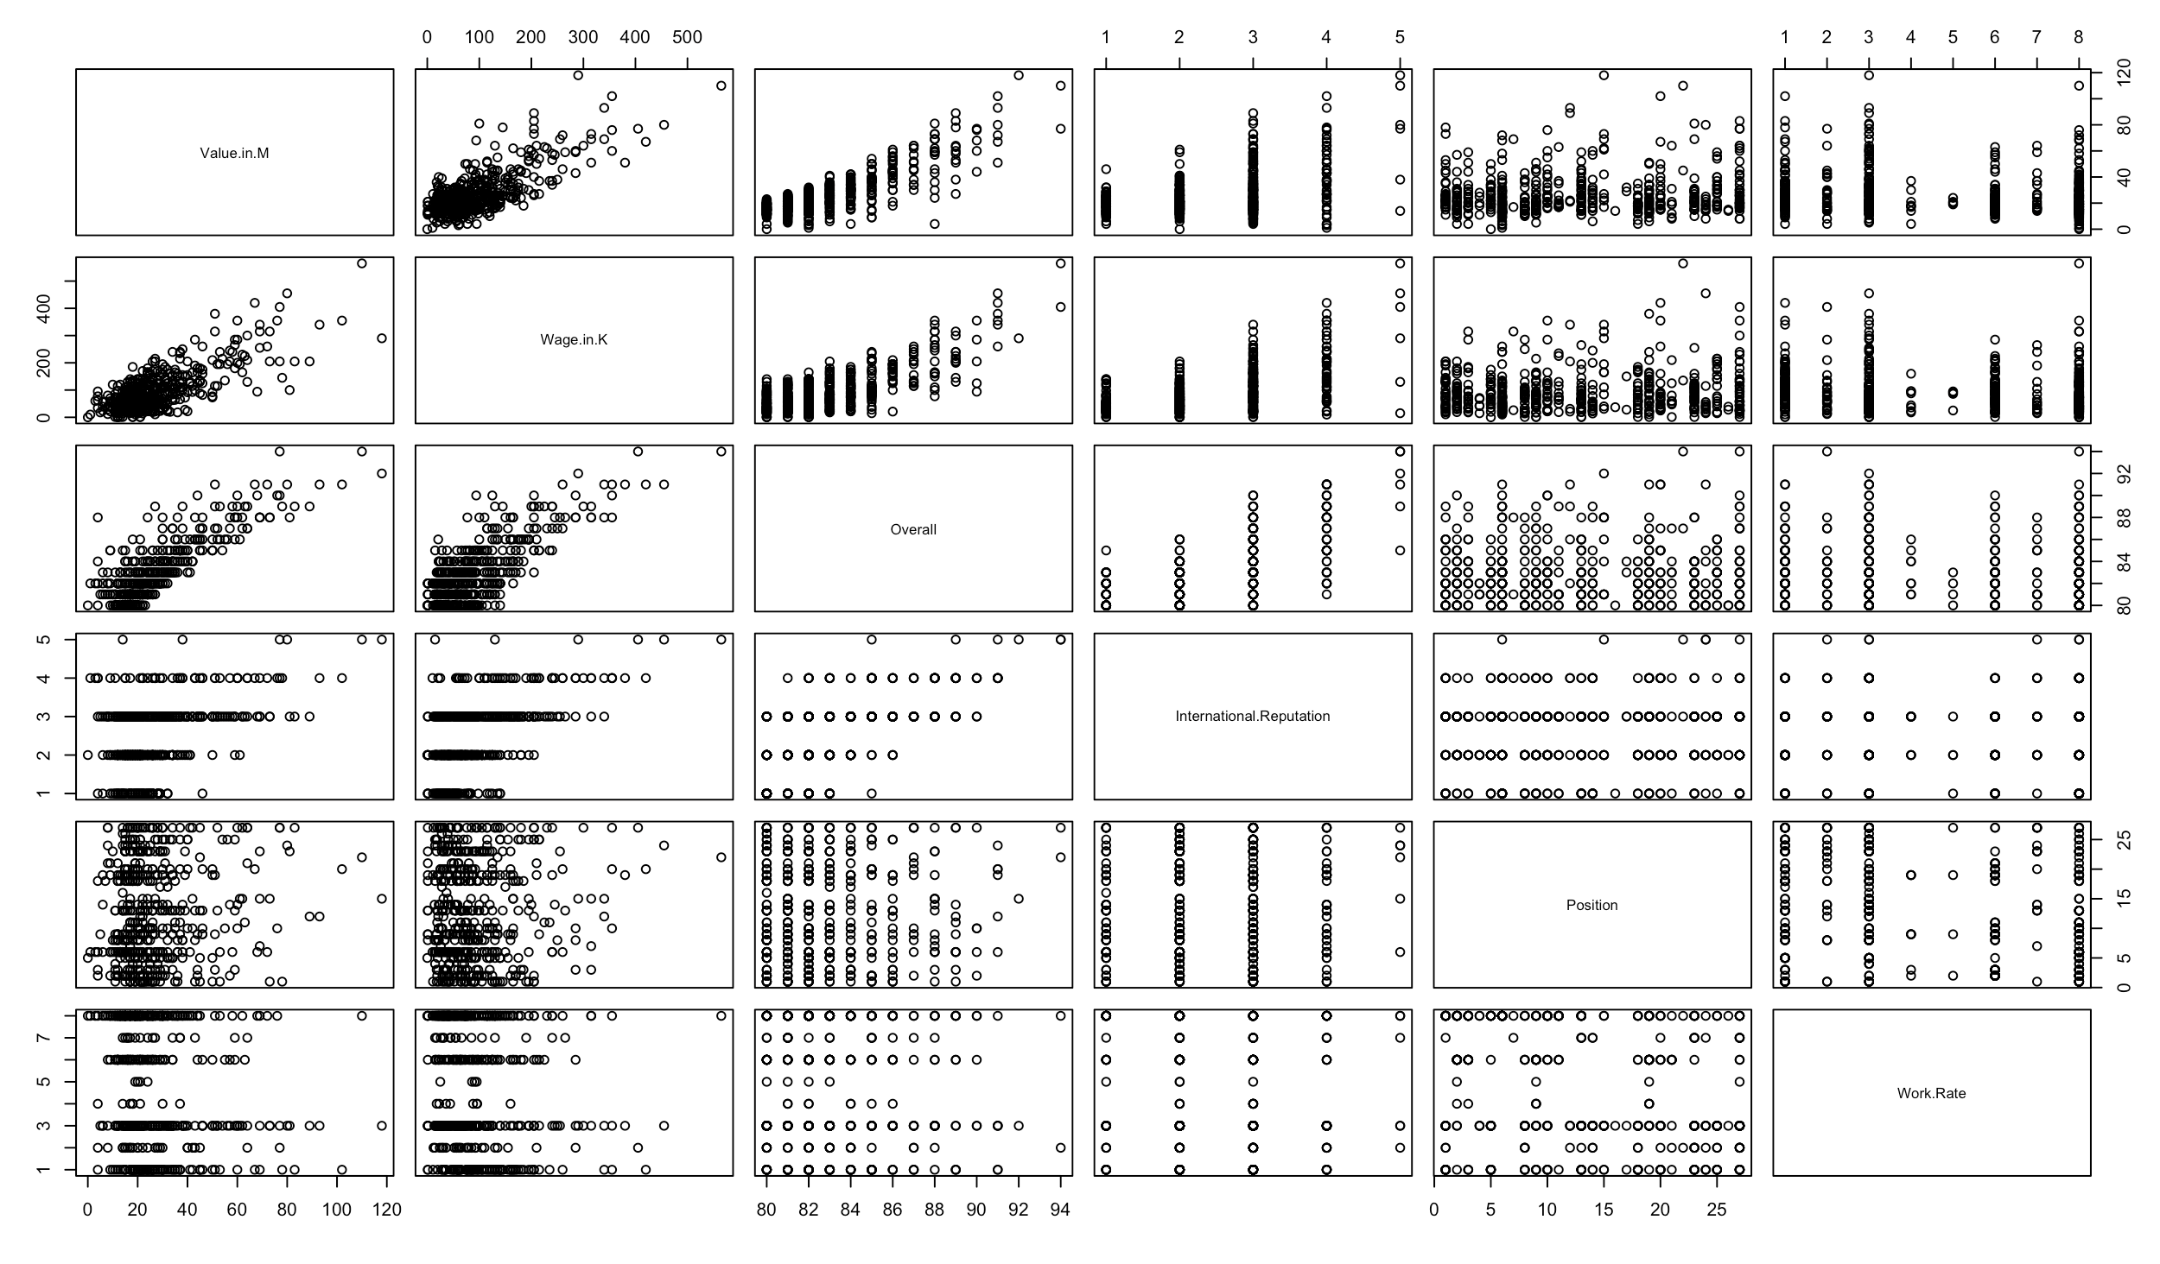

Slide 8
Preprocessing for Medicare15
Dimension reduction
Removing records with NA values
Dimensional Reordering using Parallel Coordinates
After cleaning: 48 records, 21 dimensions

Slide 9
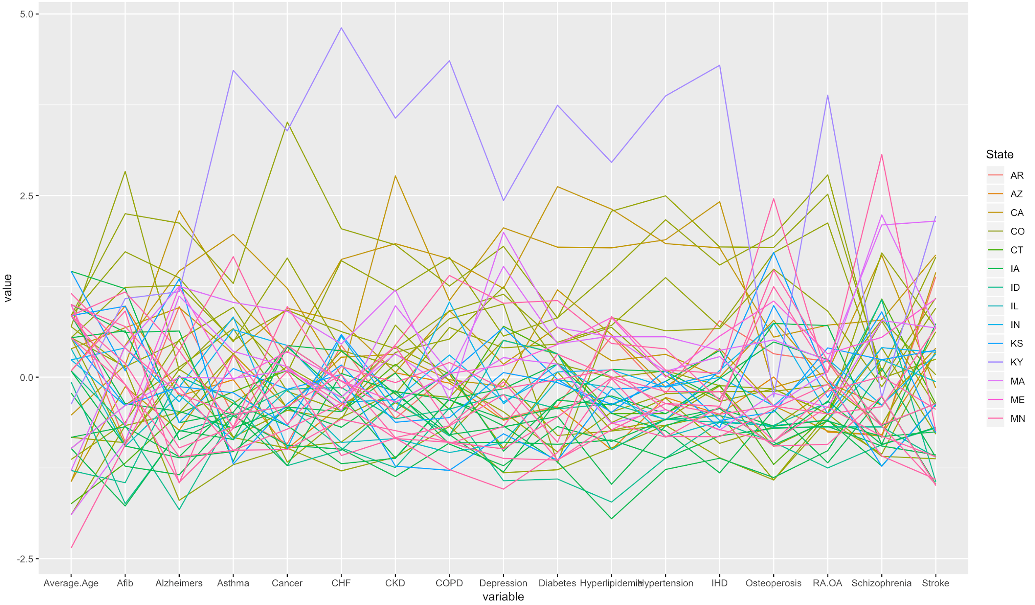

Slide 10
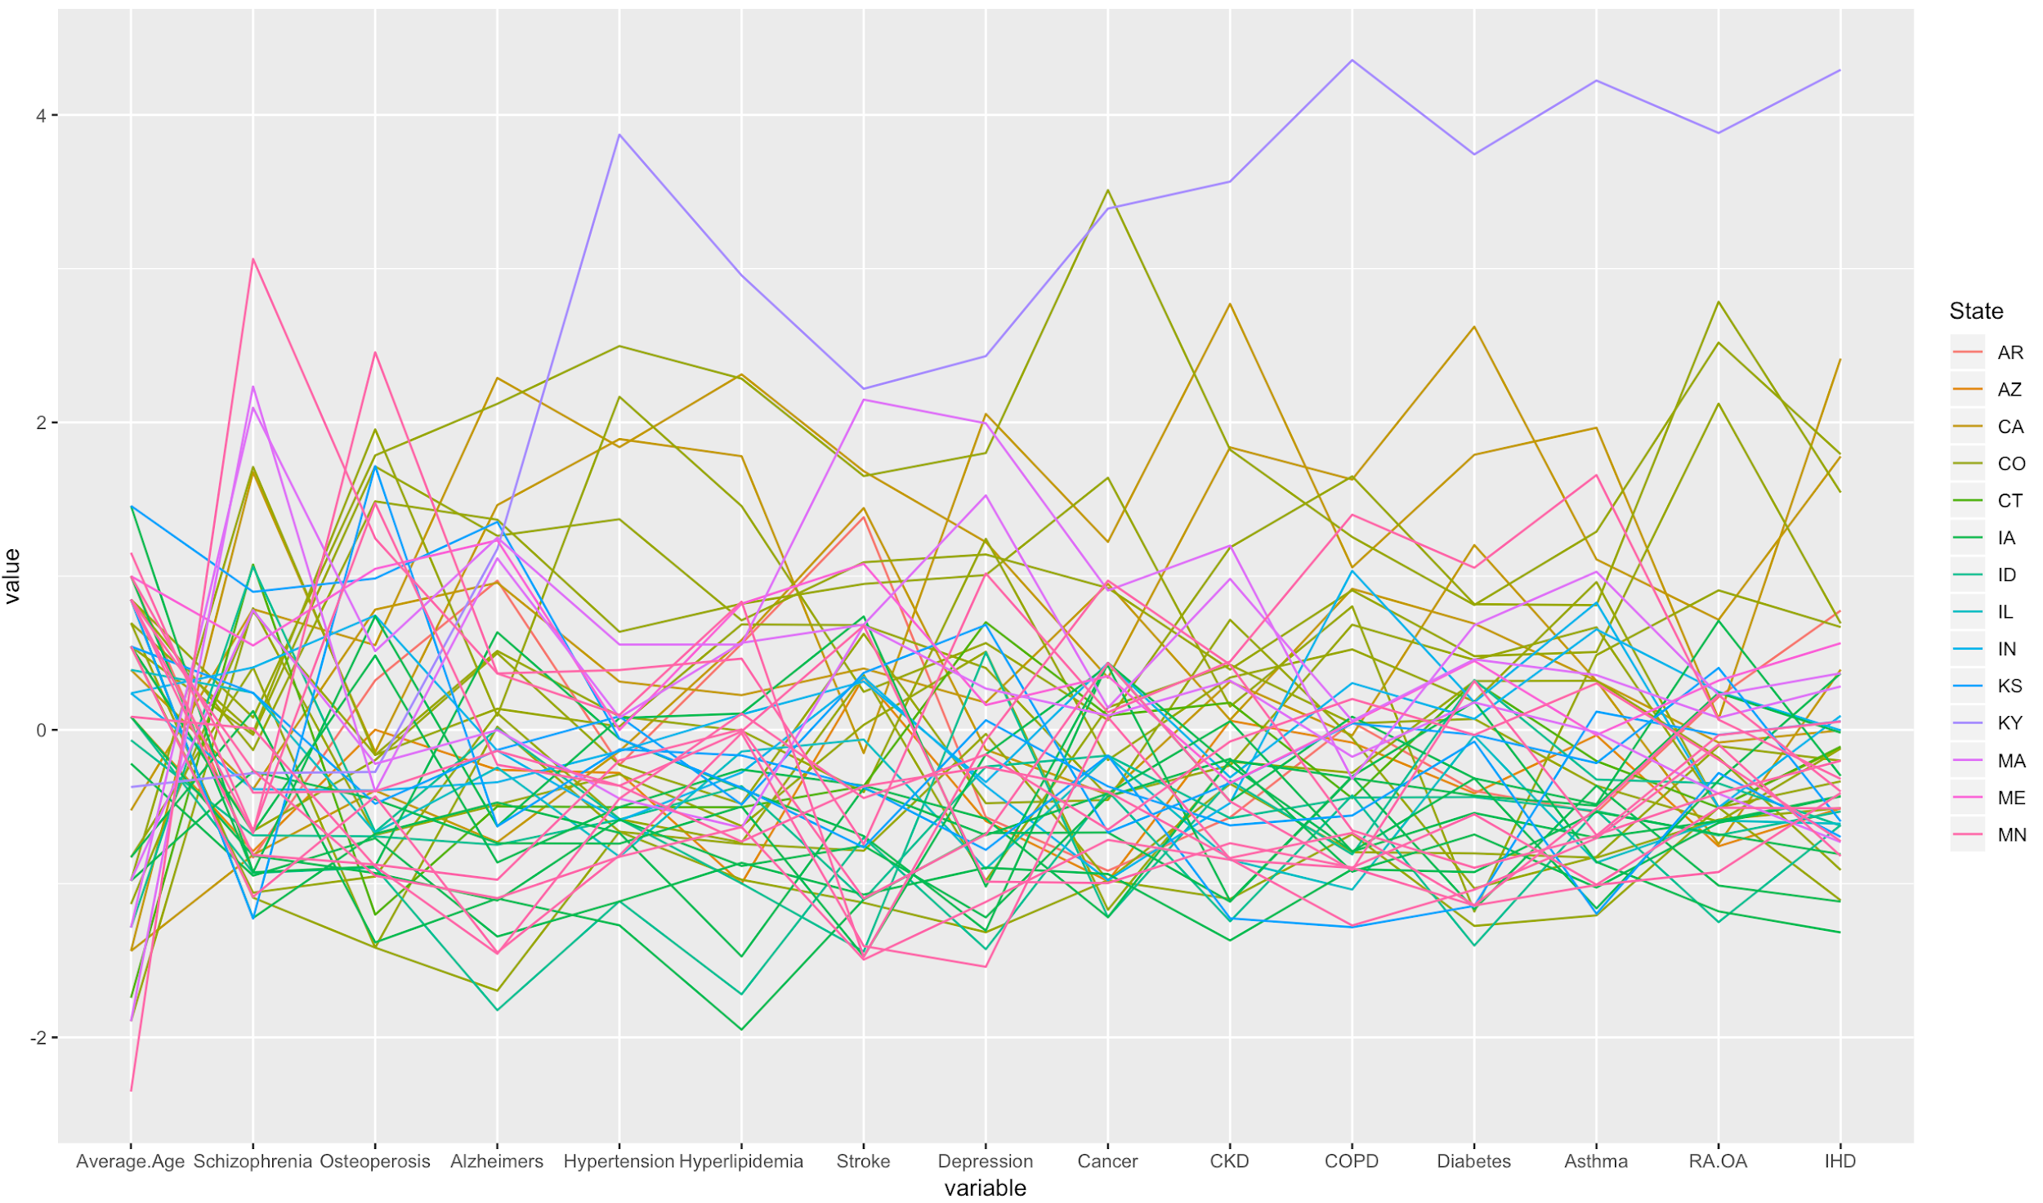

Slide 11
FIFA19 Visualizations

Slide 12
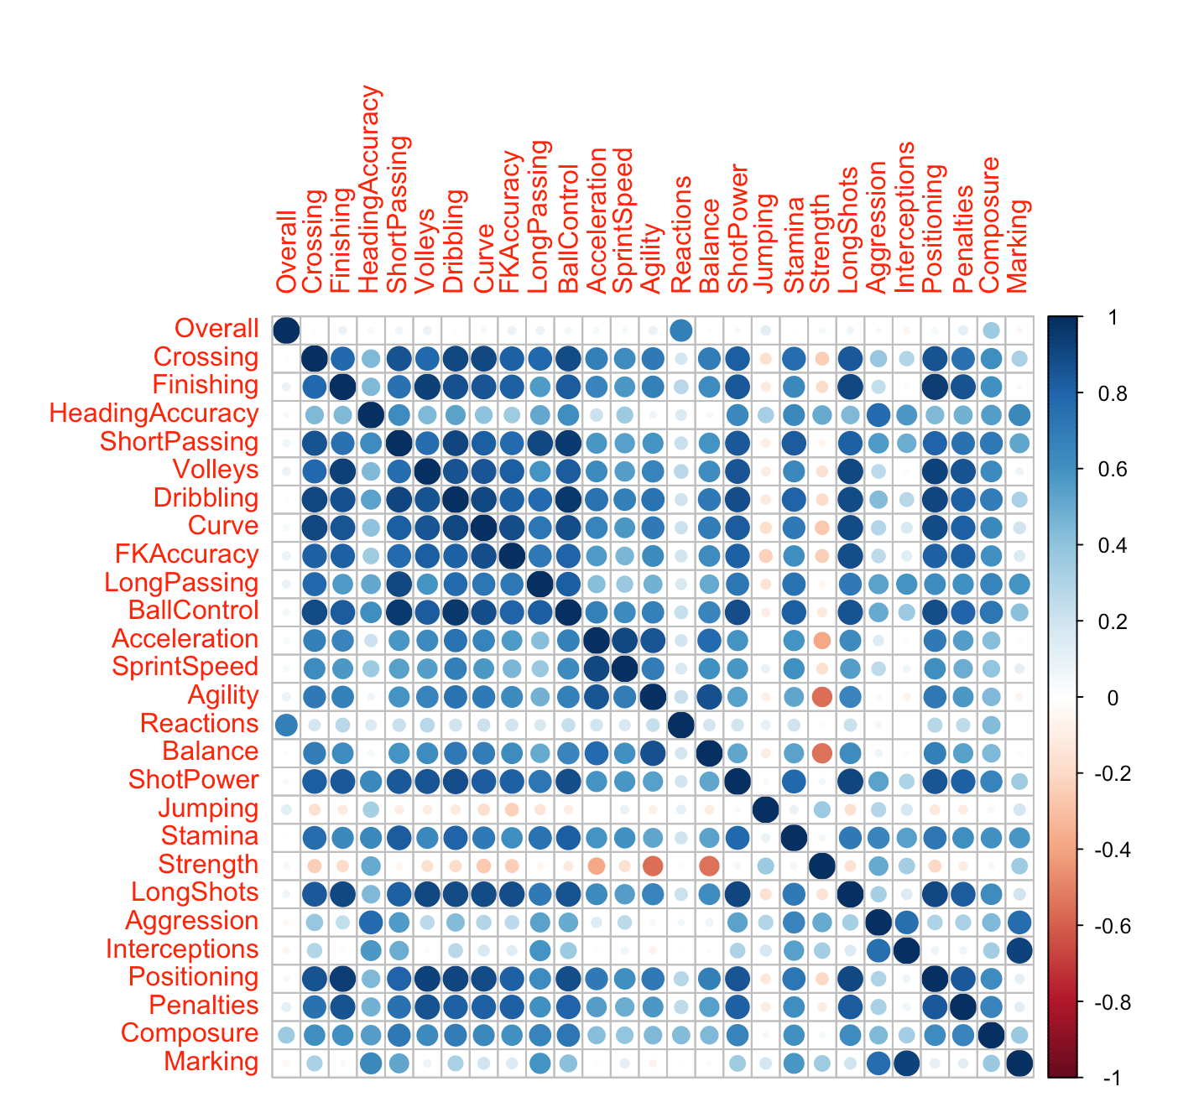

Slide 13
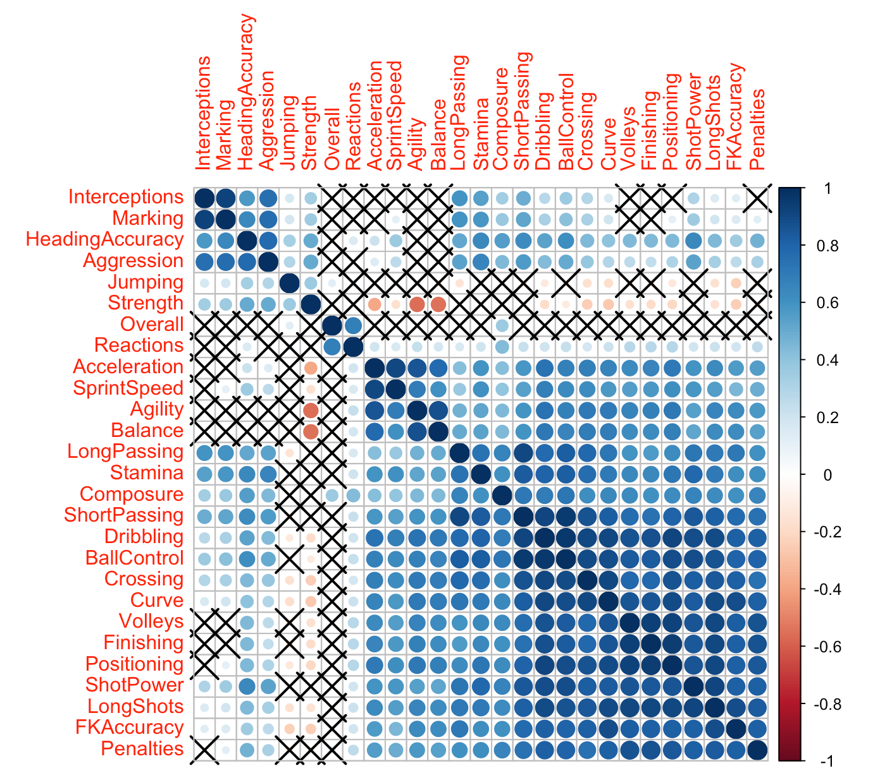

Slide 14
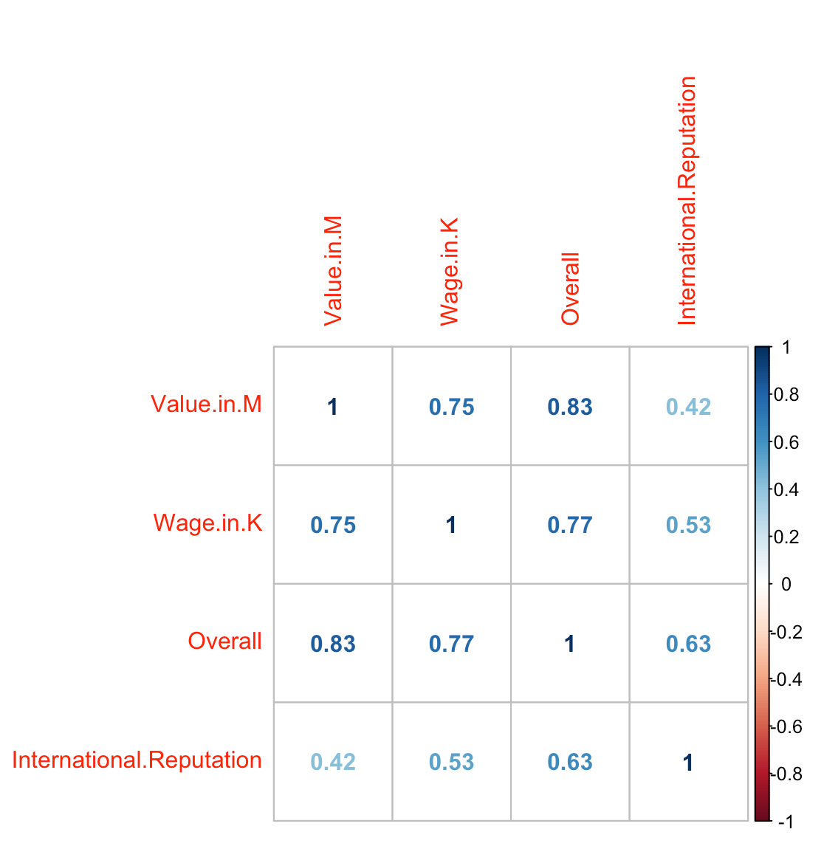

Slide 15
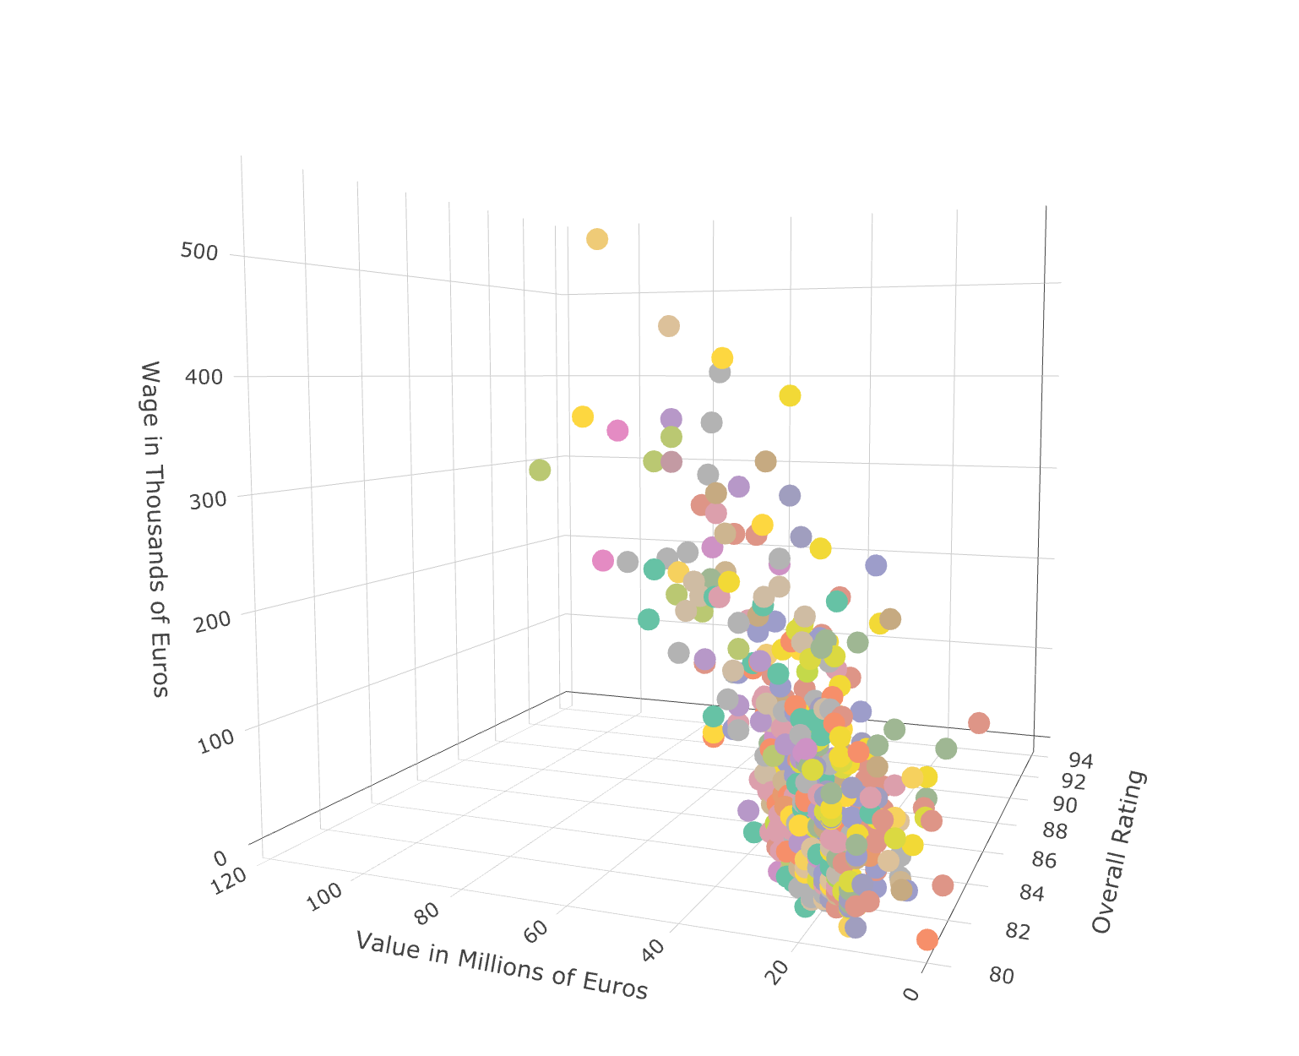
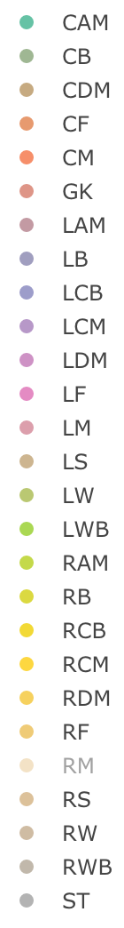

Slide 16
Med15 Visualizations
Notes:
Heyy

Slide 17
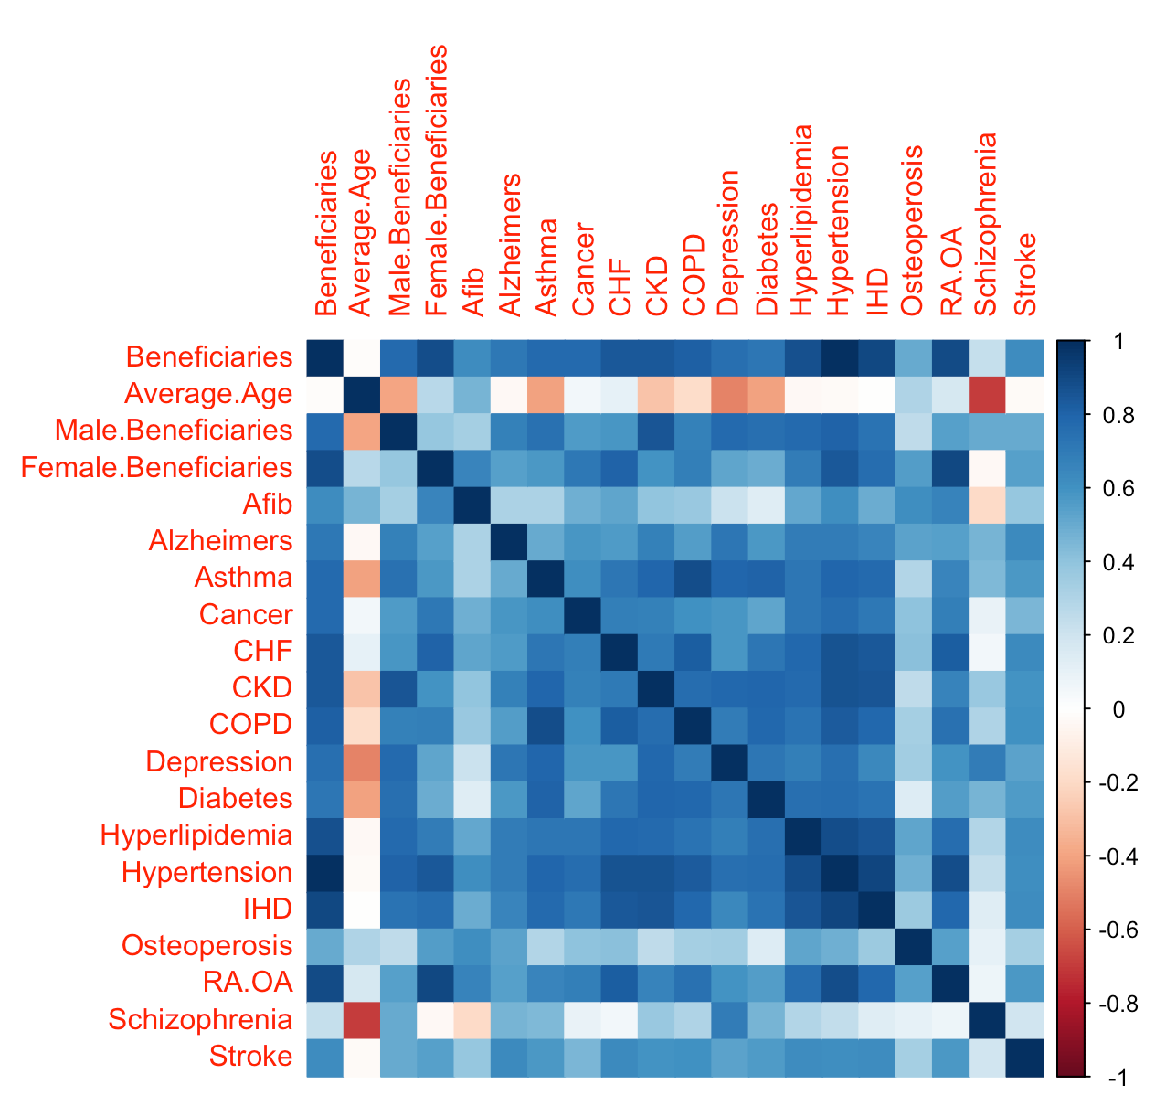

Slide 18
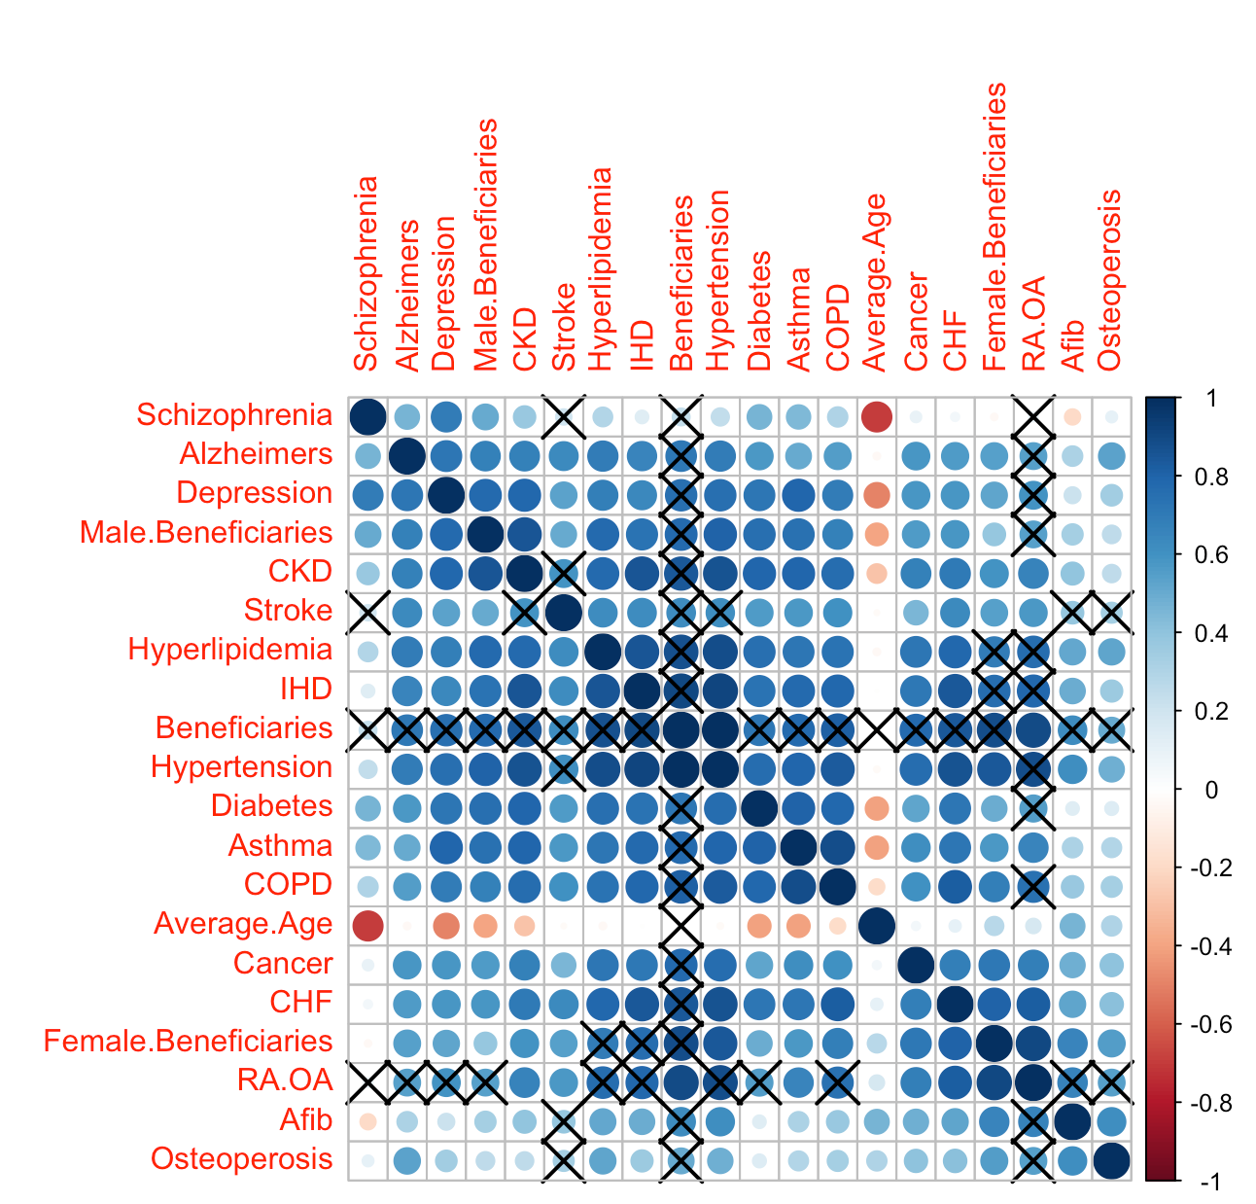

Slide 19
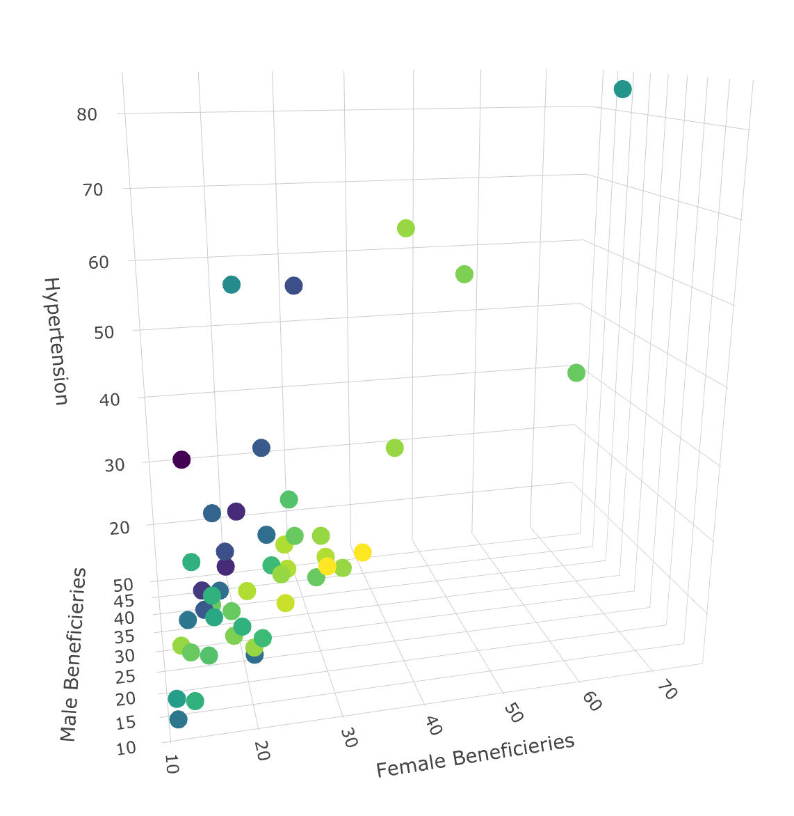
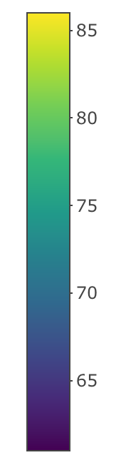

Slide 20
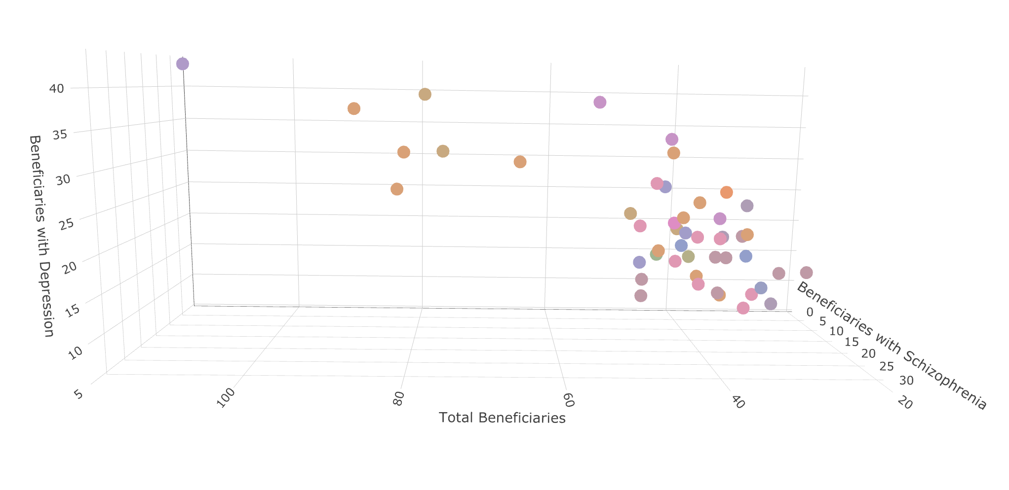
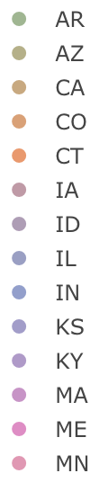

Slide 21
Future Development

Slide 22
Questions?

